Slide 1

CAPSTONE PROJECT
Presented by Hang Nguyen

Slide 2



Slide 3

PURPOSE
Make learning world capitals fun and interactive
Help users, especially students, improve memory and retention
Use gamification to boost engagement
Provide a modern, customizable quiz tool for geography learning

Slide 4

Useful for schools, trivia, travel planning, and global awareness.
Enhances geographic knowledge of countries and capitals.
Boosts memory retention and learner confidence.
Provides a fun, educational alternative to traditional materials.
Supports modern, digital learning preferences.

Slide 5

Current State of Geography Quiz Tools
Low engagement
Lack of Customization
Teacher Challenges
High Drop-off Rate

Slide 6

DESIRED STATE FOR QUIZ GAME
🎨 Fun & Visual
🔀 Variety of Quiz Types
⚡ Instant Feedback
📈 Progress Tracking
🧠 Smarter Learning
🙌 Perfect for Students & Trivia Lovers

Slide 7

COMPETITORS
Quizlet
Kahoot!
Sporcle

Slide 8
What is the current state of this industry?
High competition
Demand for niche, well- designed tools
User
engagement
Content
overload

Slide 9
What is the overall industry value-chain?
.
.
Content
Development
User Engagement
& Analytics
Technology
Platform
User Interface/User
Experience (UI/UX)
Distribution
& Marketing

Slide 10

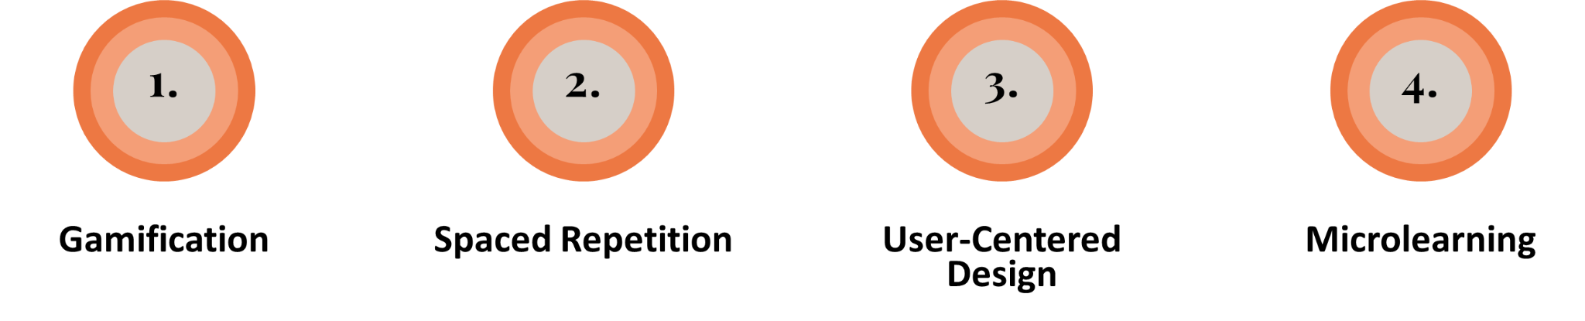

Slide 11
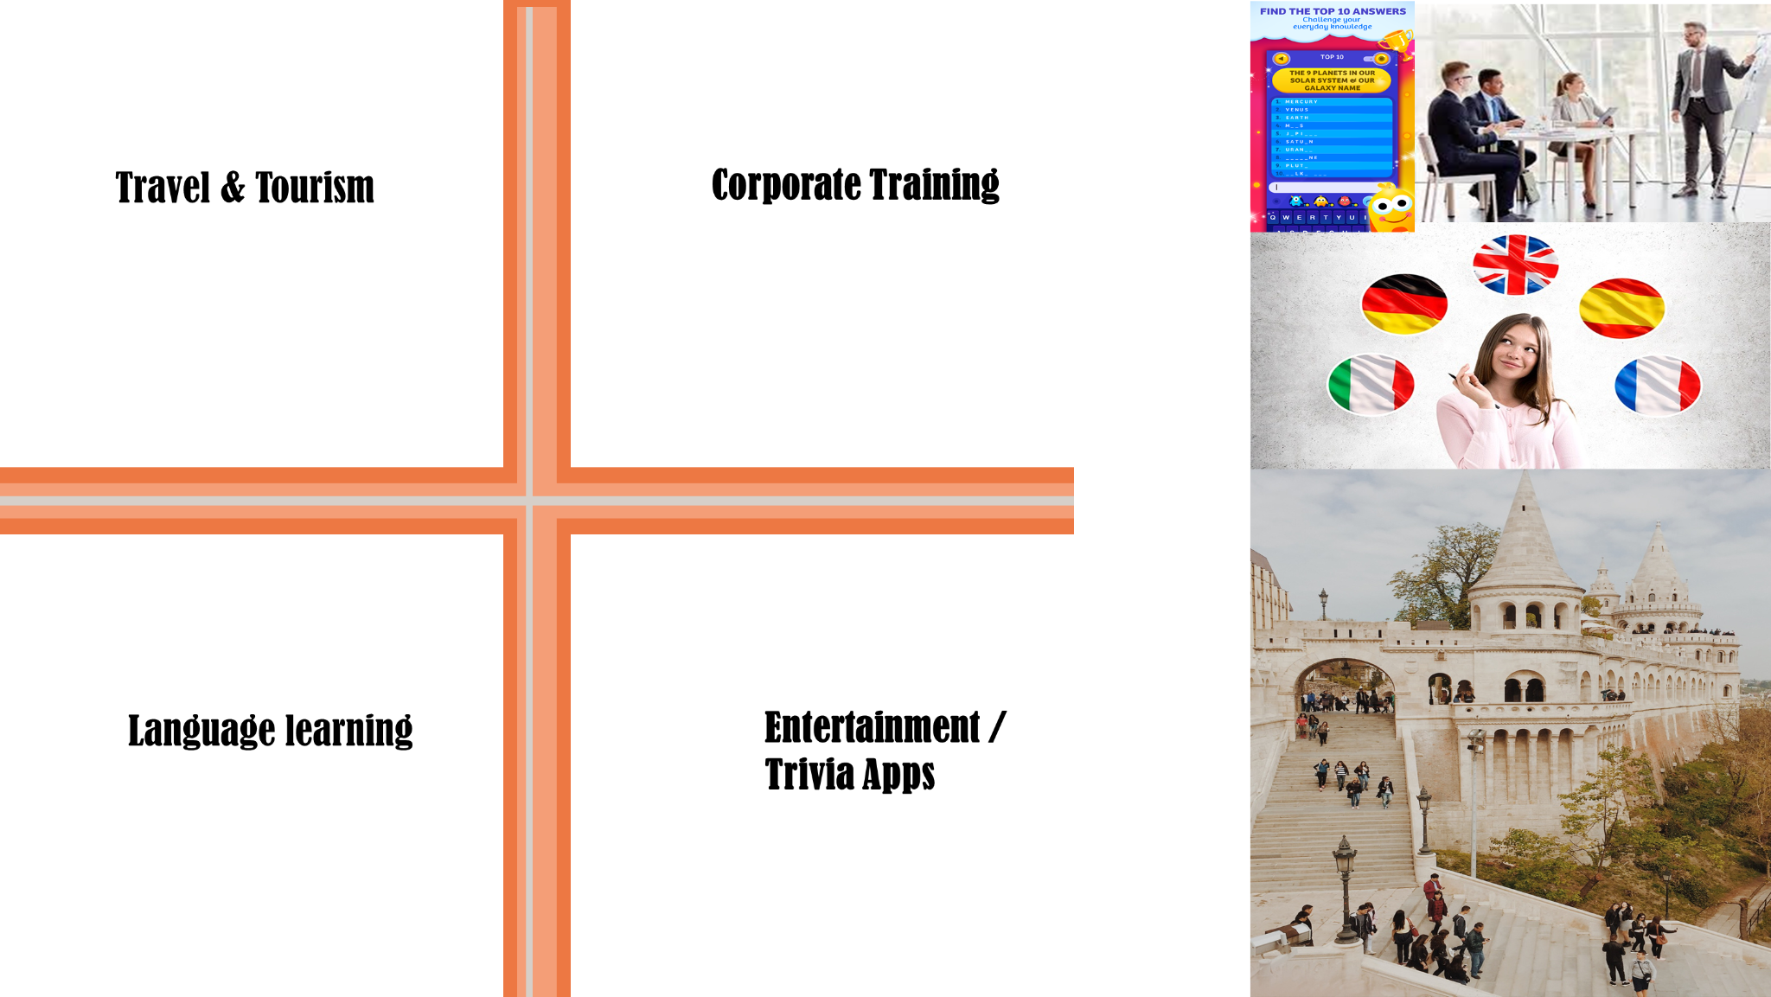
QUIZ THE GLOBE - INDUSTRY PARTICIPATION

Slide 12

STAKEHOLDERS
Students
Teachers and Educators
School and Institutions
Self learners & Trivia Enthusiasts
Parents
App Dev/Project Owner

Slide 13

Why do they care?
3Fs
FAST
FREE
FUN

Slide 14

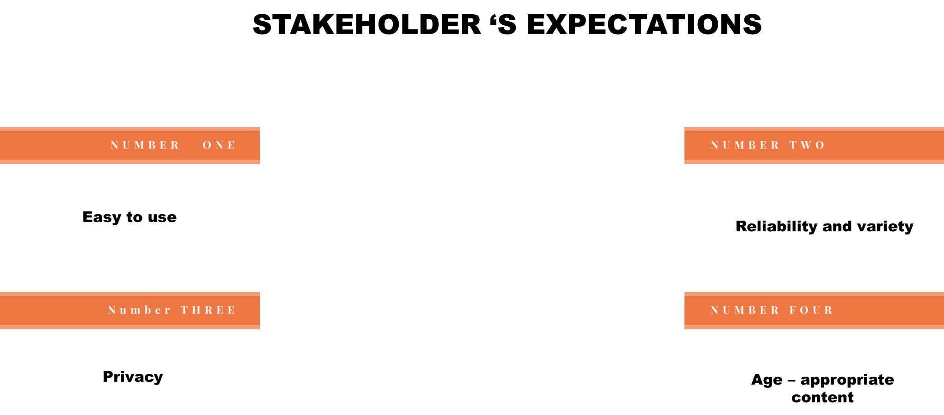

Slide 15
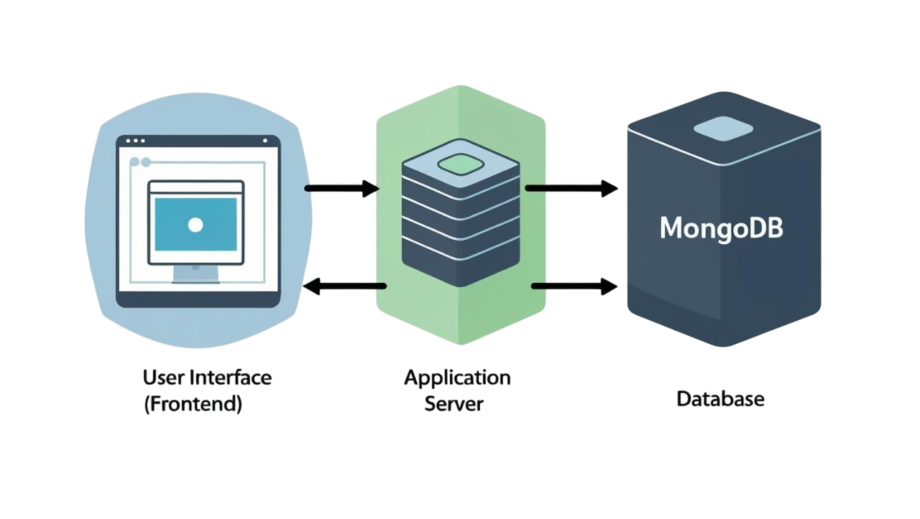
Architecture Design

Slide 16

USERS STORIES
# | User Story Title | User Story Description | Priority | Additional Notes
1 | Start Quiz | As a student, I want to start a quiz with one click so that I can immediately begin testing my knowledge of world capitals | High | The call to Action button should stand out clearly so users can click on it immediately
2 | View Quiz Questions | As a user, I want to see one question at a time with answer options so I can focus and answer easily. | High | Support multi choice questions, true/false, and fill-in-the-blank
3 | Get Immediate Feedback | As a student, I want to know right away if my answer is correct or not so I can learn from my mistakes | High | Display different sounds when I answer right or wrong.
4 | See Score at End | As a user, I want to see my score after completing the quiz so I can track my performance | High | Display final score and correct answers.

Slide 17
5 | Display Countries List | As a user, I want to view a list of countries with flags, names, capitals, population, region, and currency so I can learn about different countries clearly. | High | Responsive grid, clickable cards with hover effects
6 | Search Countries by Name | As a user, I want to search countries by name using autocomplete with flag icons so I can quickly find a specific country. | High | Supports free text, flag icons in dropdown
7 | Filter Countries by Region | As a user, I want to filter countries by region to browse countries in a specific geographic area. | Medium | Dropdown with “All” option
8 | Sort Countries by Name or Population | As a user, I want to sort countries alphabetically or by population size to explore countries in my preferred order. | Medium | Sort options: None, Name (A–Z), Population (descending)
9 | View Country Details in Modal | As a user, I want to click a country card to see detailed info in a modal dialog so I can learn more without leaving the page. | High | Modal shows flag emoji, capital, region, population, currency

Slide 18

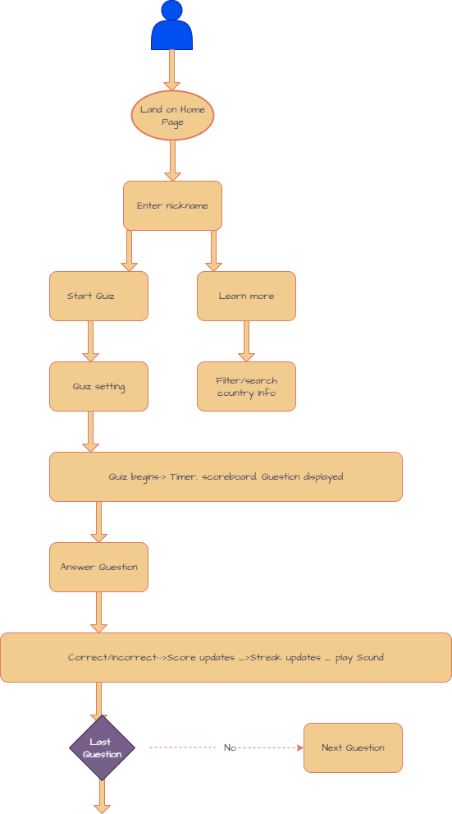
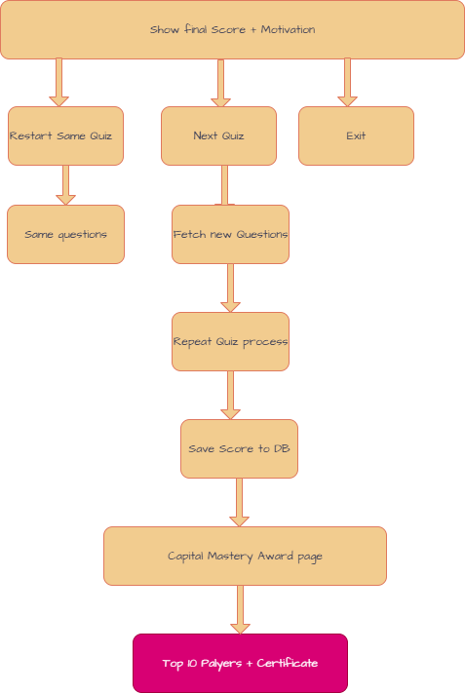
USER FLOW
USER LOGIN TO THE QUIZ GAME
USER FINISHES THE QUIZ GAME

Slide 19

Figma Designs

Slide 20
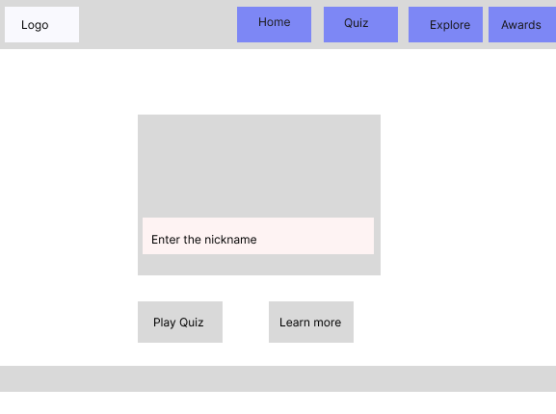
LANDING PAGE - HOME

Slide 21
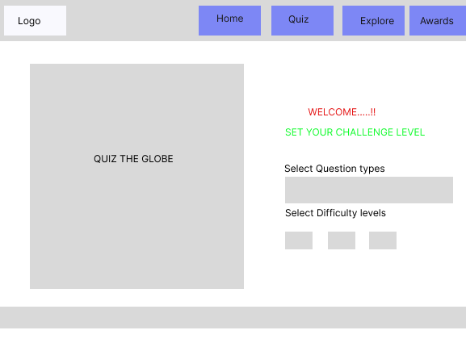
QUIZ PAGE

Slide 22
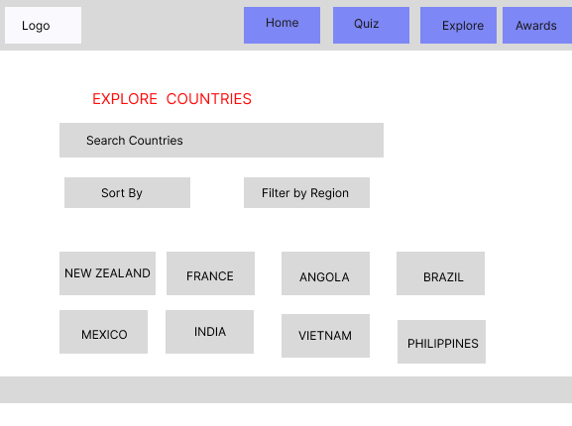

Slide 23
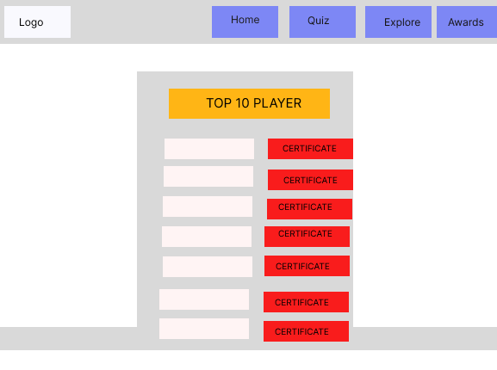
CAPITAL MASTERY AWARDS PAGE

Slide 24


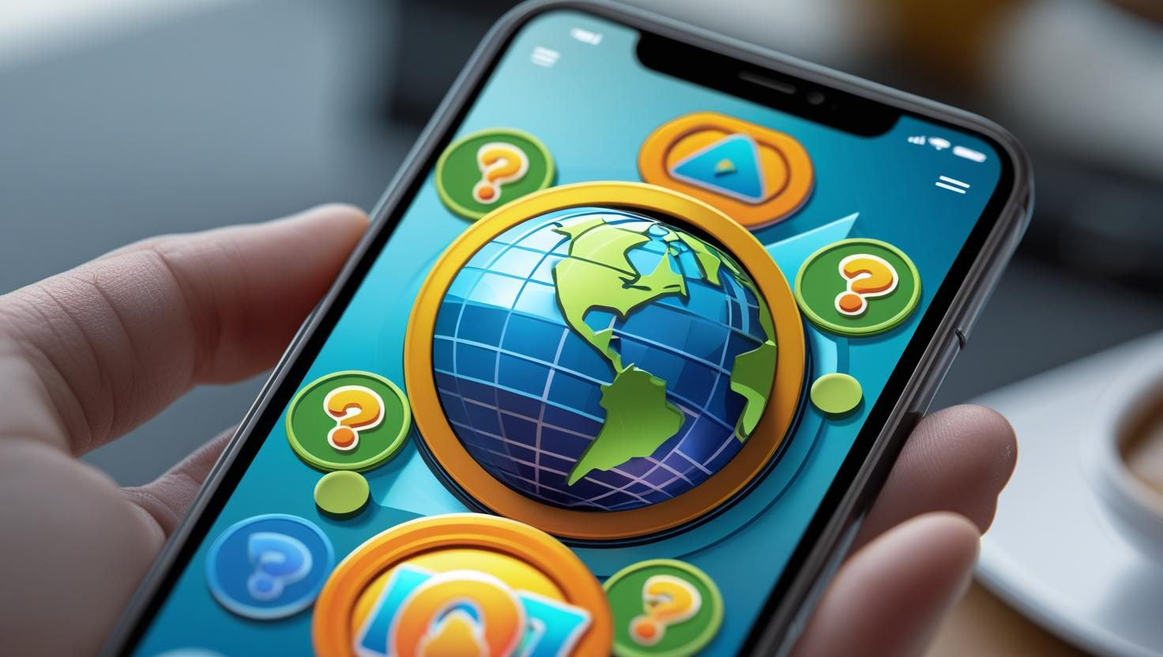
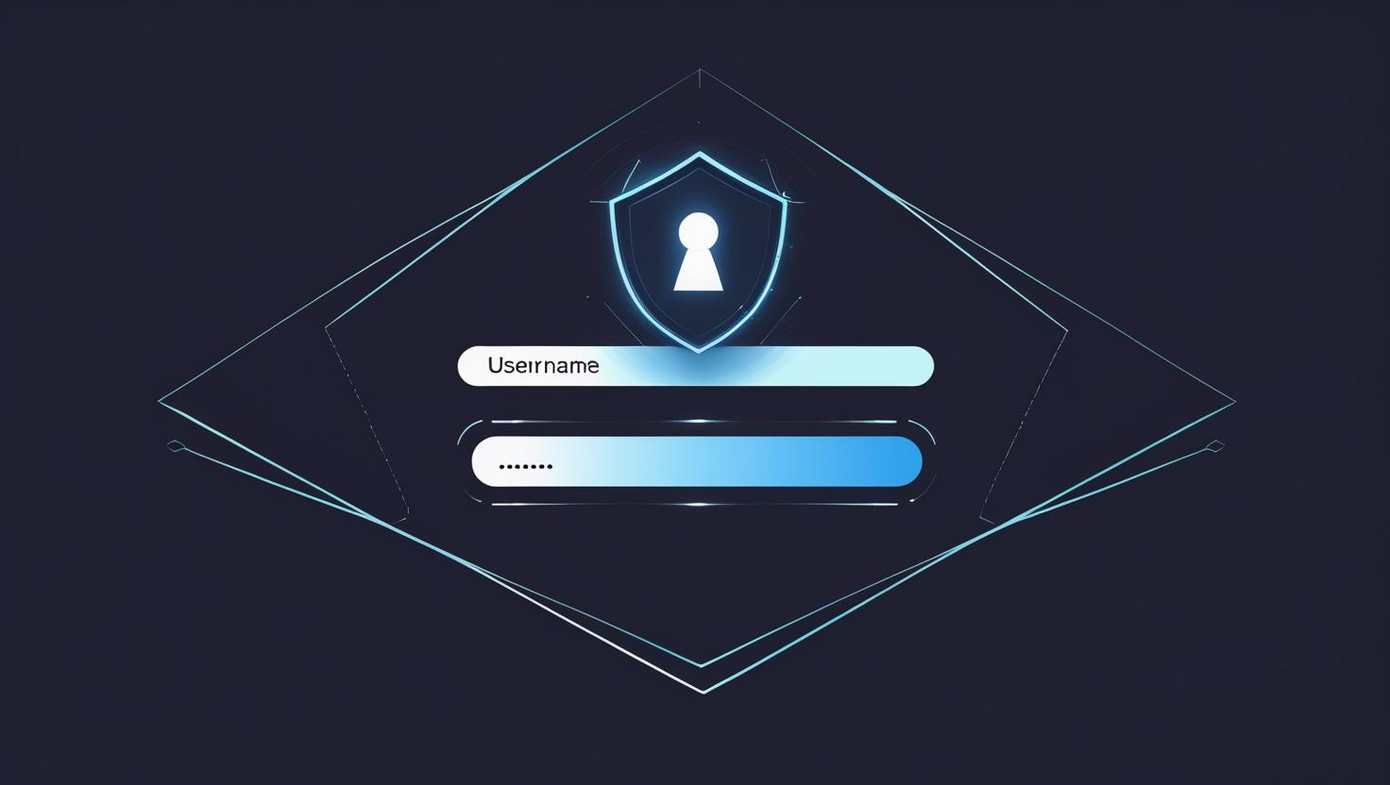
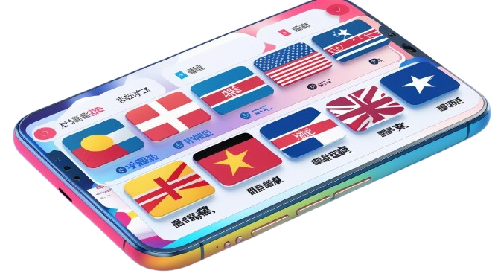
Out of Scope
Encryption / HTTPS
Optimization for mobile
User Authentication
Multi languages support

Slide 25
Non-functional requirements
Availability - 24/7
Maintainability - easy to update
Performance - 3 seconds

Slide 26

PROJECT PLANNING
Monday | Tuesday | Wednesday | Thursday | Friday | Saturday | Sunday
 | 1/7 Start planning + start documenta tion | 2/7 Lo-Fi Design + Logical model of database | 3/7 Finish documentation + Lo- Fi design - DONE | 4/7 Start building front-end Adding in component s + pages | 5/7 Homepage front-end Done | 6/7 Start backend - create models and controllers ensure all CRUD
7/7 Back-end controllers Back-end models - Routes DONE | 8/7 Quiz page Explore page for front end DONE | 9/7 Capital Mastery Award page for front end DONE | 10/7 Finish main build of back end Done Mongo DB connected CRUD check- DONE | 11/7 Integrate all code in main branch and fix any bugs | 12/7 Tidy up and fix bugs | 13/7 tidy up the code Done Comment Code DONE
14/7 Making the presentation file Done | 15/7 Finish Documentation DONE | 16/7 Prepare for the presentation | 17/7 | 18/7 | 19/7 Presentation day

Slide 27

TESTING
1
Figma design
2
Thunder Client CRUD testing
3
Manually tested components
User testing
4
5
Code reviewed and commented

Slide 28
IMPLEMENTATION
The application should be deployed to AWS EC2 free tier through Docker and the server database should be deployed to Amazon Web Services Relational Database Service.

Slide 29
QUIZ THE GLOBE CODE
https://github.com/hangnznguyen/CAPSTONEPROJECT.git

Slide 30
Resources used:
Resou
Visual Studio Code
dotenv
Draw.io
Front end
React
React Router DOM
Material UI / Icons
API
NodeJS
Express
Mongodb
External APIs AND Data Sources
https://restcountries.com/
ces used

Slide 31
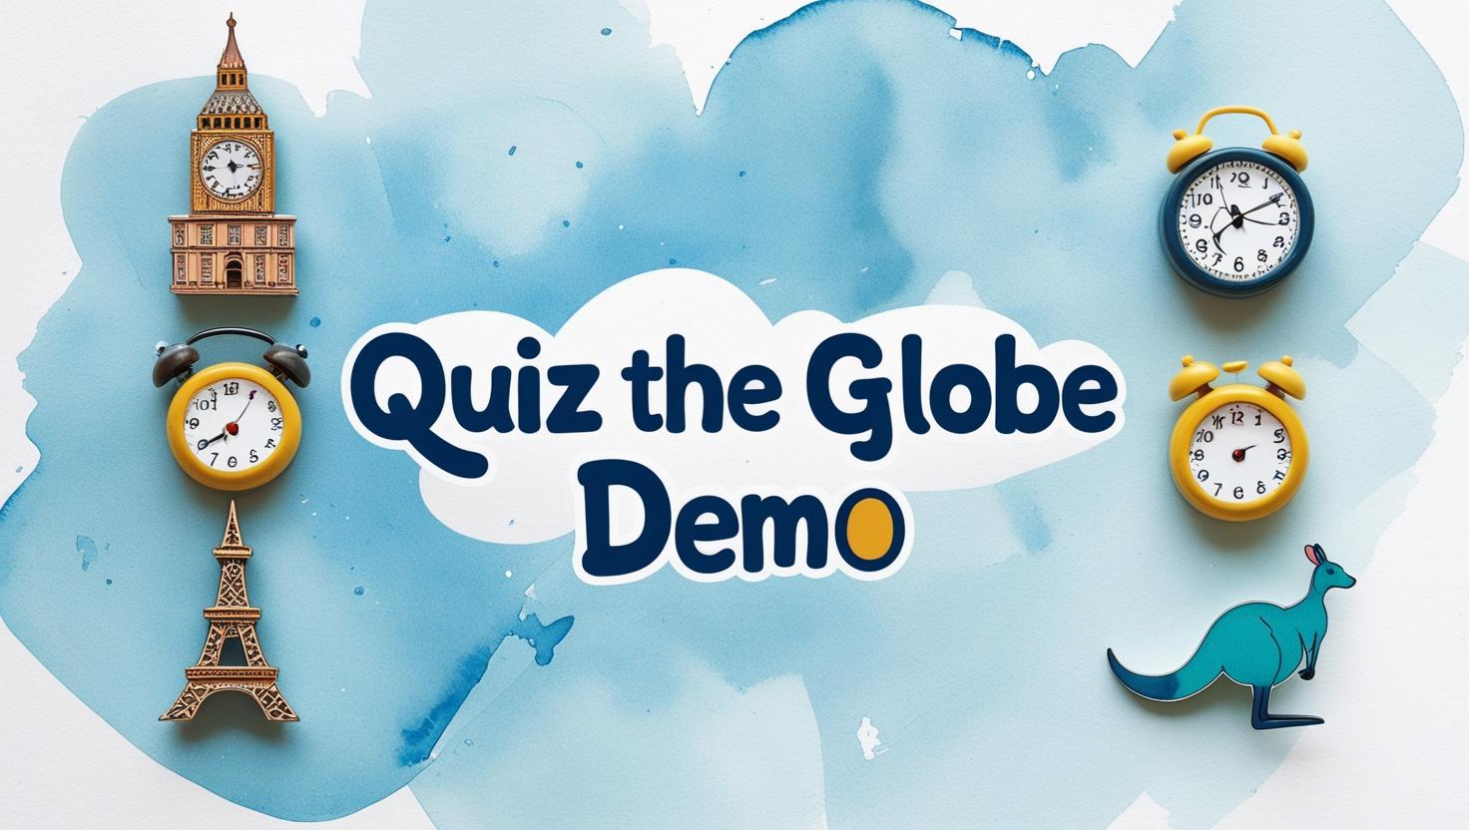

Slide 32


Slide 33


